Slide 1


Mallek Abdelmalek
12-06-2022

Slide 2

Outline
Executive Summary
Introduction
Methodology
Results
Conclusion
Appendix

Slide 3
Executive Summary
Summary of methodologies
Data collection
Data wrangling
EDA with data Visualization
EDA with SQL
Building interactive map with folium
Building a Dashboard with plotly dash
Predictive analysis (Classification)
Summary of all results
EDA with result
Interactive analysis demo
Predictive analysis

Slide 4
Introduction
Project background and context:
We’re setting a predictive study about Falcon9 first stage if it will land successfully, SpaceX recommended Falcon9 rockets launch on its site with only 62M $ cost, while other sites cost up to 165M $ each, much of the saving is that SpaceX can reuse the first stage, So if we can prove the success of first stage landing, we can determine the cost of a launch, The final information can reused if an alternate company wants to bid against SpaceX for a rocket launch
Problems you want to find answers
The main task in this project is to find using all the data science techniques if the first stage of SpaceX Falcon 9 rocket will land successfully by analyzing all the features and finding patterns

Slide 5

Section 1

Slide 6
Methodology
Executive Summary
Data collection methodology:
Web scrapping from Wikipedia
SpaceX rest API
Perform data wrangling
Data processing by cleaning, sorting and filtering it, then One hot encoding data field for ML models
Perform exploratory data analysis (EDA) using visualization and SQL
Perform interactive visual analytics using Folium and Plotly Dash
Perform predictive analysis using classification models
Decision tree, Logistic regression, KNN, SVM models built and evaluated by all metrics

Slide 7
Data Collection
The data was collected as follow:
We worked with SpaceX launch dataset that is gathered from the SpaceX rest API
The API will give us insights about launches Including info about the rocket used, payload delivered, launch specification, landing specification and landing outcomes
SpaceX URL starts with http://api.spacexdata.com/v4/
Another useful method which is web scrapping Wikipedia using Beautiful Soup to extract Falcon9 launch data
Using SpaceX API
API returns SpaceX data in Json
Norm data and convert it to CSV
Get HTML response from Wikipedia
Extract data using Beautiful Soup
Norm data and convert it to CSV
SpaceX API
Web Scrapping

Slide 8

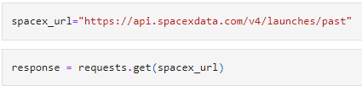
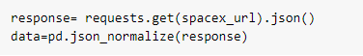
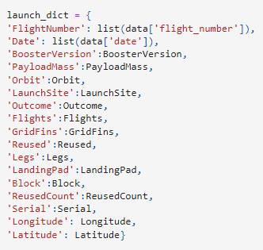
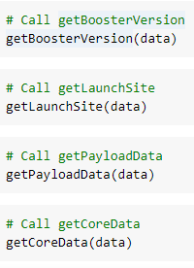
Data Collection – SpaceX API
1-Get response rom API
Process of data collection with API
IBM-Applied-DS-capstone/data collection API.ipynb at main · MallekAbd/IBM-Applied-DS-capstone (github.com)
2-convert the response to Json file
3-apply custom function
to clean data
4-Assign list to dict then dataframe
5-Process dataframe then export it as csv

Slide 9
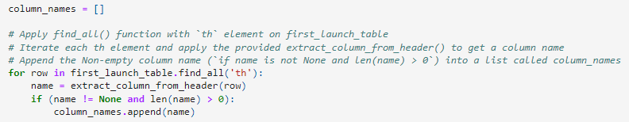
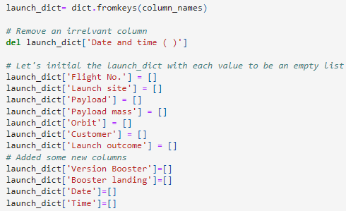
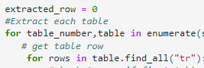
Data Collection - Scraping
Web scraping from wikipedia
IBM-Applied-DS-capstone/data collection web scraping.ipynb at main · MallekAbd/IBM-Applied-DS-capstone (github.com)
1- Get the response from HTML
2-Beautifi Soup object’s creation
3-finding tables
4-column names
5-setting up dictionary
7-convert data to df then export it as csv
6-adding data to keys block[16]

Slide 10
Data Wrangling
The Process
Calculate the number of launches each site
Calculate the number and occurrence of each orbit
Perform EDA on dataset
Handle null values
Create a landing outcome label from outcome column
Calculate nb and occurrence of mission outcome per orbit type
IBM-Applied-DS-capstone/labs-jupyter-spacex-Data wrangling.ipynb at main · MallekAbd/IBM-Applied-DS-capstone (github.com)

Slide 11
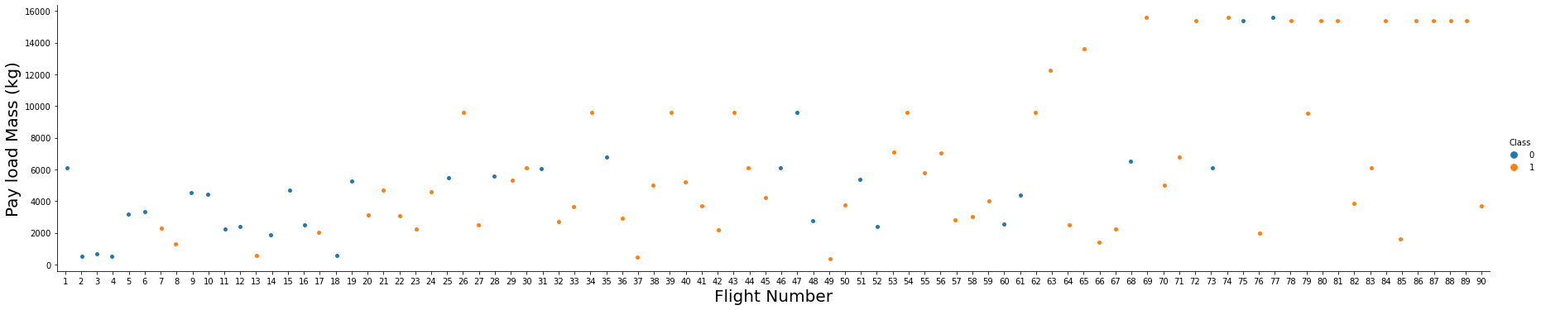
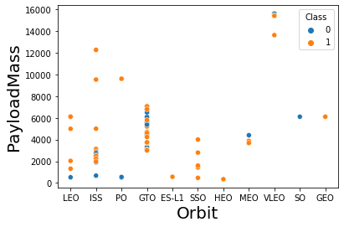
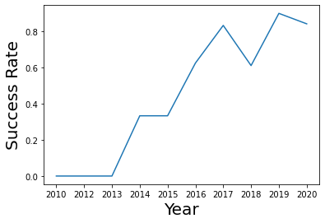
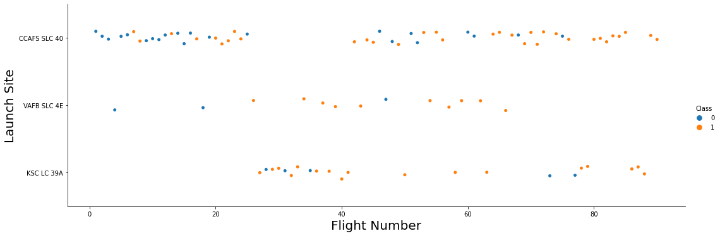
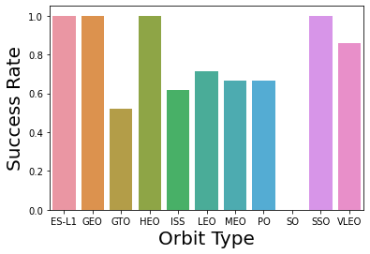
EDA with Data Visualization
Scatter graphs:
Line graphs drawn:
Payload mass
flight number
Bar graphs drawn:
Launches site
IBM-Applied-DS-capstone/EDA with Visualization lab.ipynb at main · MallekAbd/IBM-Applied-DS-capstone (github.com)
flight number

Slide 12
EDA with SQL
Display the names of the unique launch sites in the space mission
Display 5 records where launch sites begin with the string 'CCA'
Display the total payload mass carried by boosters launched by NASA (CRS)
Display average payload mass carried by booster version F9 v1.1
List the date when the first succesful landing outcome in ground pad was acheived.
List the names of the boosters which have success in drone ship and have payload mass greater than 4000 but less than 6000
List the total number of successful and failure mission outcomes
List the names of the booster_versions which have carried the maximum payload mass. Use a subquery
List the records which will display the month names, failure landing_outcomes in drone ship ,booster versions, launch_site for the months in year 2015
Rank the count of successful landing_outcomes between the date 2010-06-04 and 2017-03-20 in descending order.
IBM-Applied-DS-capstone/EDA with SQL lab.ipynb at main · MallekAbd/IBM-Applied-DS-capstone (github.com)

Slide 13
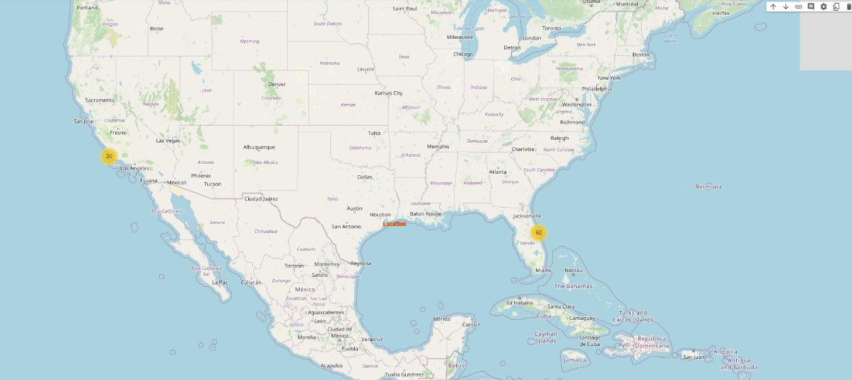
Build an Interactive Map with Folium
To visualize the launch data into an interactive map, we took the latitude and longitude coordinates at each launch site and added a circle Marker around each launch with a label of the name of the launch site
We assigned the dataframe outcome( failures, success) to class 0 and 1 green and red markers on the map in a MarkerCluster()
Using Haversine Formulas we calculated the distance from the launch site to various trends about what is around it to measure patterns, Lines are drawn on the map to measure distance to Landmarks
IBM-Applied-DS-capstone/Interactive Visual Analytics with Folium lab.ipynb at main · MallekAbd/IBM-Applied-DS-capstone (github.com)

Slide 14
Build a Dashboard with Plotly Dash
Graphs:
Pie chart showing the total launches by almost all sites
Display relative proportions of multiples classes of data
Size of circle can be made proportional to the total quantity it represents
Scatters:
Shows the relationship with both payload mass and outcome for different booster version
Shows the relationship between two variables
The best way to show a non-linear pattern
Shows the observation and their readings

Slide 15
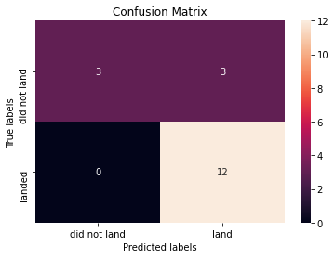
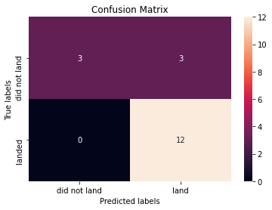
Predictive Analysis (Classification)
Model building:
Loading the dataframe into pandas and numpy
Transform the data and split it into train and test datasets
Choose the machine learning algorithms to use
Set the parameters and algorithms to GridsearchCV then fit the dataset into GridsearchCV objects and train our dataset
Model evaluation:
Calculate the accuracy for each model and plot the confusion matrix
Choosing the best performing model:
The model with the best performing accuracy is the chosen one

Slide 16
Results
The SVM,KNN,LR are the best models in terms of predictions accuracy of this dataset
Low weighted payloads perform better than the heavier payload
The success rate of the spacex launches is directly proportional time in years they will eventually perfect the launches
KSC LC 39A had the most launches from all sites

Slide 17

Section 2

Slide 18
Flight Number vs. Launch Site
Launches rom the site CCAFS SLC 40 are significantly higher than the launches from other sites

Slide 19
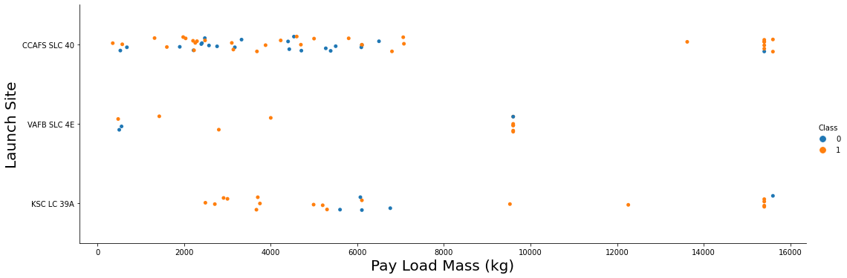
Payload vs. Launch Site
The majority of lower payload mass has launched from CCAFS SLC 40

Slide 20
Success Rate vs. Orbit Type
Orbit GEO, HEO, SSO, ES-L1 has the best success rate

Slide 21
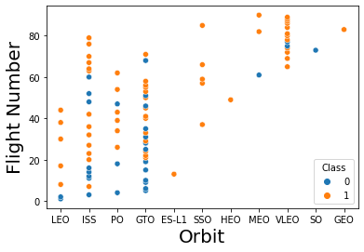
Flight Number vs. Orbit Type
In the LEO orbit, the success is related to the number of flights, also a trend can be observed of shifting to VLEO launches recently

Slide 22
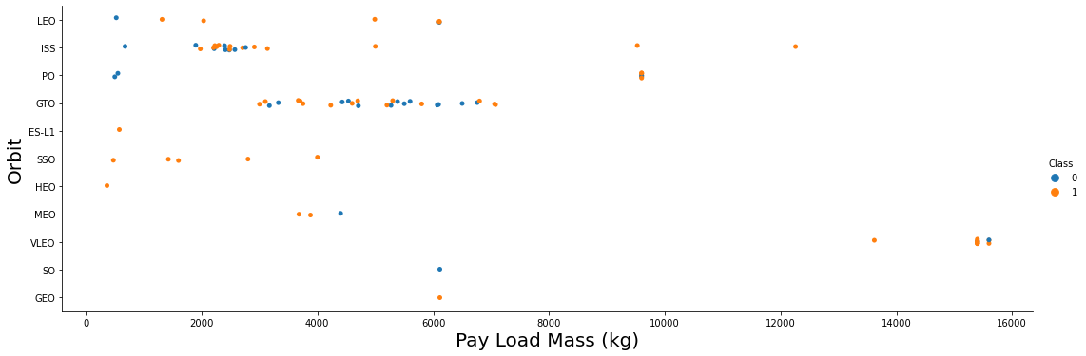
Payload vs. Orbit Type
There’s a strong correlation between ISS and payload at the range of 2000 as well between GTO and the range 4000-8000

Slide 23
Launch Success Yearly Trend
you can observe that the success rate since 2013 kept increasing till 2029 where is began to be stable, due to the technology and learning

Slide 24
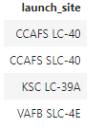
All Launch Site Names
The Query:
The result:
Using the command Distinct in the query means that it will only show unique values in the launch site column from table SpaceX

Slide 25
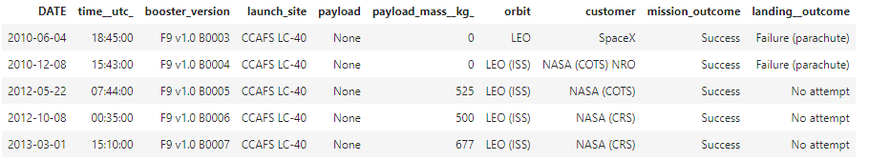
Launch Site Names Begin with 'CCA'
Query:
Result:
Using the command LIMIT 5 shows only the first results that respect the condition

Slide 26
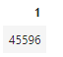
Total Payload Mass
Query:
Result:
Using the function SUM return the total in the column Payload_Mass_kg

Slide 27
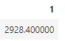
Average Payload Mass by F9 v1.1
Query:
Result:
The function AVG returns the average of the column Payload_Mass_KG and the command where filters the data to perform the calculation

Slide 28
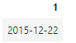
First Successful Ground Landing Date
Query:
Result:
The function MIN returns the minimum date and the where clause filters the data we perform on the calculation

Slide 29
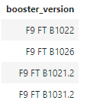
Successful Drone Ship Landing with Payload between 4000 and 6000
Query:
Result:
Selecting only Booster Version which have success in drone ship and have payload mass greater than 4000 but less than 6000

Slide 30
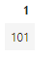
Total Number of Successful and Failure Mission Outcomes
Query:
Result:
The function count(*) returns the total value count in the column and where clause filters the data which to perform calculation on

Slide 31
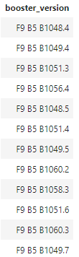
Boosters Carried Maximum Payload
Query:
Result:
Using the command Distinct in the query means that it will only show unique values in the launch site column from table SpaceXTBL and where clause filters the data which to perform calculation on

Slide 32
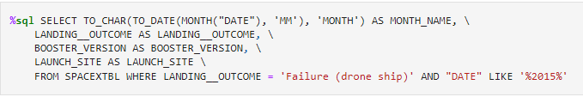
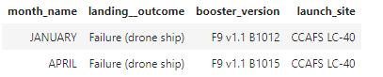
2015 Launch Records
Query:
Result:

Slide 33
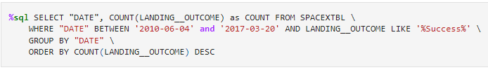
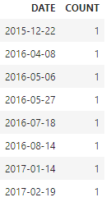
Rank Landing Outcomes Between 2010-06-04 and 2017-03-20
Query:
Result:
Function Count returns records in the column SpaceXTBL and where clause filters the data which to perform calculation on, Group By puts the list in order set to a certain condition, DESC means its arranging the dataset into descending order

Slide 34

Section 3

Slide 35
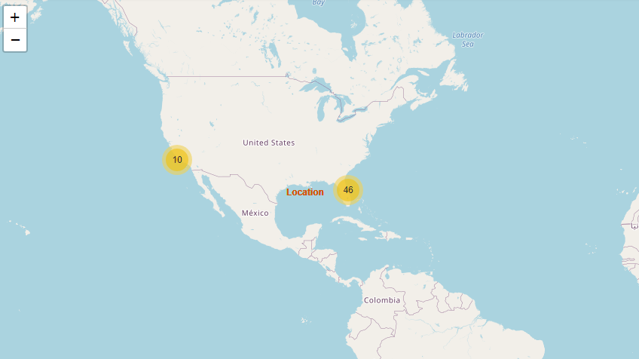
Global launches sites- success and failures
We can notice that the spaceX launches are situated in eastern and western coasts ( CA-FL)

Slide 36
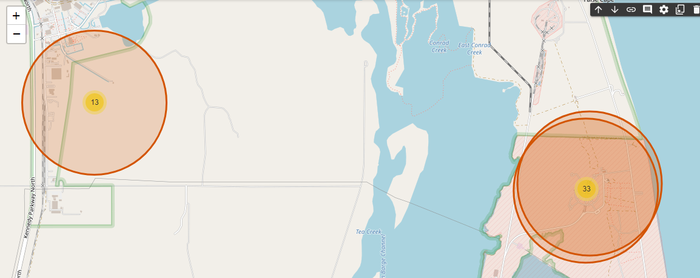
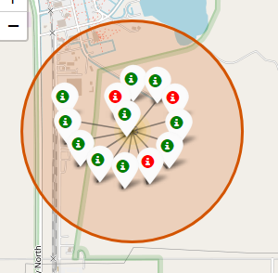
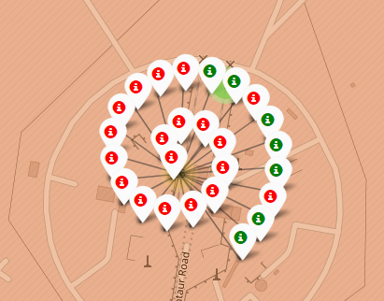
Colored Labeled markers-Florida
Green marks shows successful launches where the red ones show the failures

Slide 37
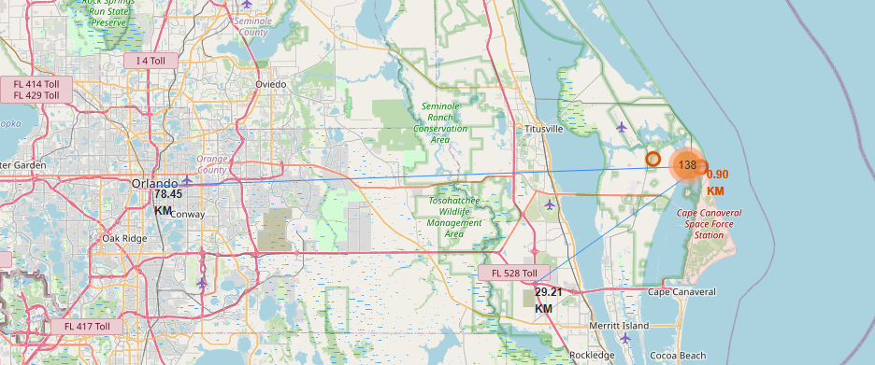
Distance between a launch site to its proximities

Slide 38

Section 4

Slide 39
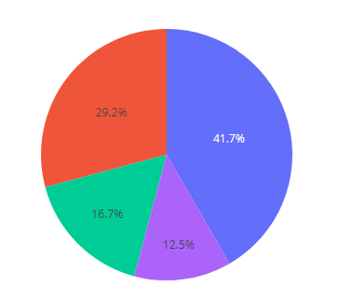
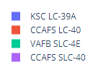
Total launches or all sites
We notice that the KSC LC 39A had the most successful launches from all sites

Slide 40
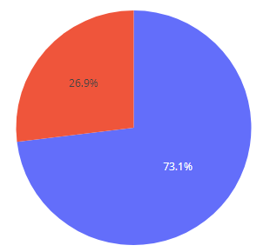
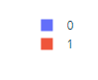
Success rate by site CCAFS LC 40
CCAFS LC 40 achieved 73,1% success launch while getting 26,9% failure

Slide 41
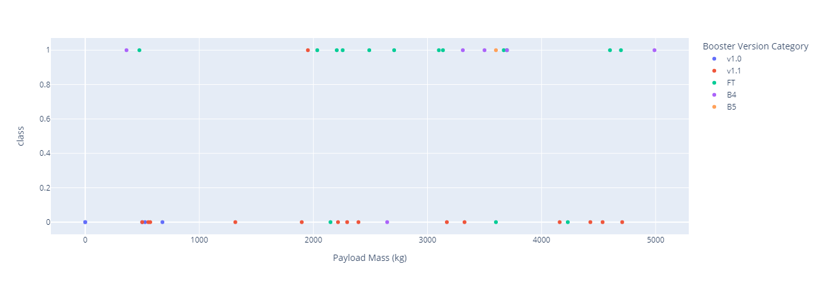
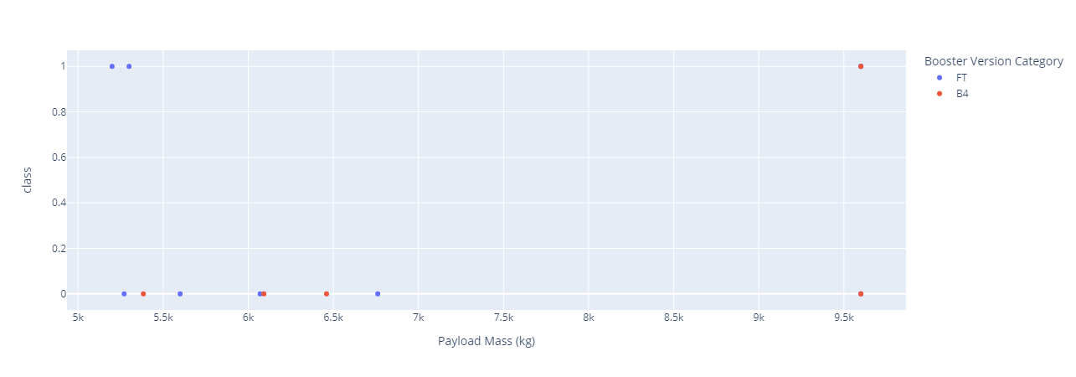
Payload mass vs Launch outcome
The success rates for low weighted payloads is higher than the heavy weighted payloads

Slide 42

Section 5

Slide 43
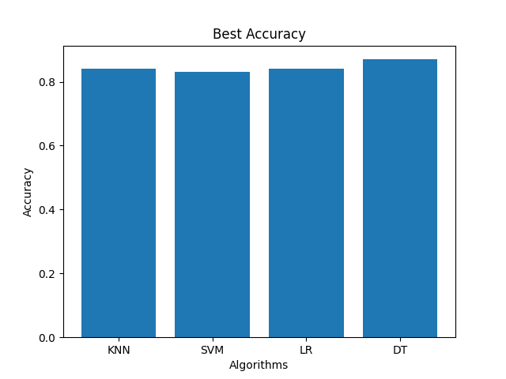
Classification Accuracy
As we can see the accuracy of all these algorithms are significantly close, but the decision tree has the highest accuracy by 0,87

Slide 44
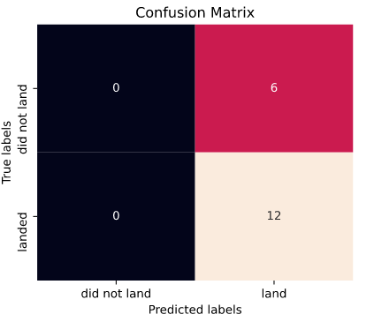
Confusion Matrix
Analysing the confusion matrix, we see that tree can distinguish between all the classes, as we can notice that the biggest issue is the False positive
TP | TN
FP | FN
Negative positive
Negative positive

Slide 45
Conclusions
The SVM,KNN,LR are the best models in terms of predictions accuracy of this dataset
Low weighted payloads perform better than the heavier payload
The success rate of the spacex launches is directly proportional time in years they will eventually perfect the launches
KSC LC 39A had the most launches from all sites

Slide 46
Appendix
Haversine Formulas
ML with python

Slide 47


